Slide 1
Introduction
Chapter 1
Computer Networks, Fifth Edition by Andrew Tanenbaum and David Wetherall, © Pearson Education-Prentice Hall, 2011

Slide 2
Uses of Computer Networks
Business Applications
Home Applications
Mobile Users
Social Issues
Computer Networks, Fifth Edition by Andrew Tanenbaum and David Wetherall, © Pearson Education-Prentice Hall, 2011

Slide 3
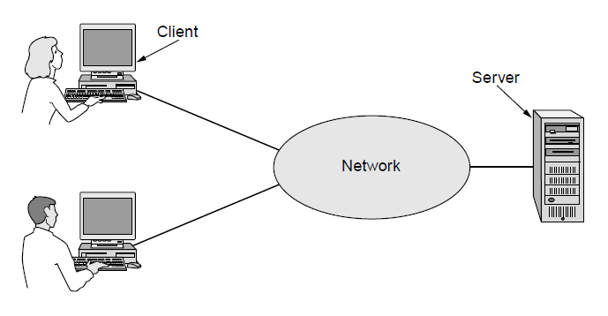
Business Applications (1)
A network with two clients and one server
Computer Networks, Fifth Edition by Andrew Tanenbaum and David Wetherall, © Pearson Education-Prentice Hall, 2011

Slide 4
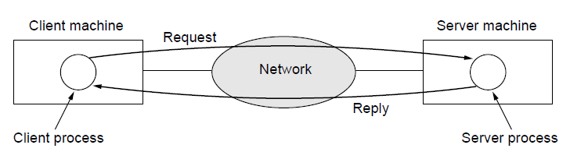
Business Applications (2)
The client-server model involves requests and replies
Computer Networks, Fifth Edition by Andrew Tanenbaum and David Wetherall, © Pearson Education-Prentice Hall, 2011

Slide 5
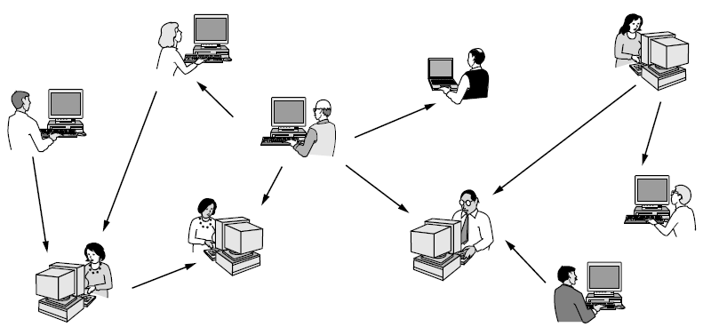
Home Applications (1)
In a peer-to-peer system there are no fixed clients and servers.
Computer Networks, Fifth Edition by Andrew Tanenbaum and David Wetherall, © Pearson Education-Prentice Hall, 2011

Slide 6
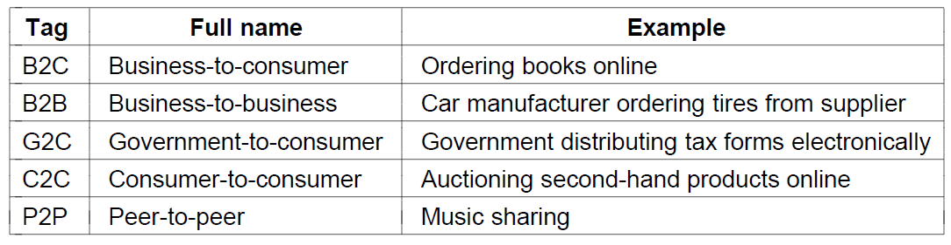
Home Applications (2)
Some forms of e-commerce
Computer Networks, Fifth Edition by Andrew Tanenbaum and David Wetherall, © Pearson Education-Prentice Hall, 2011

Slide 7
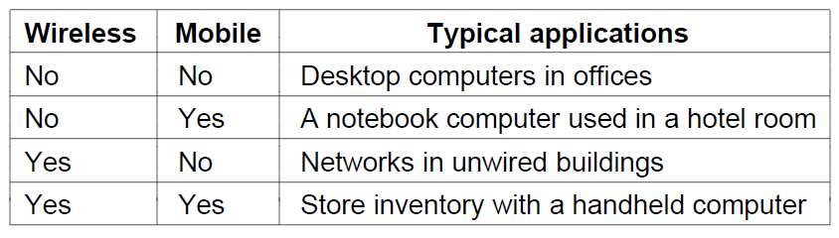
Mobile Users
Combinations of wireless networks and mobile computing
Computer Networks, Fifth Edition by Andrew Tanenbaum and David Wetherall, © Pearson Education-Prentice Hall, 2011

Slide 8
Social Issues
Network neutrality
Digital Millennium Copyright Act
Profiling users
Phishing
Computer Networks, Fifth Edition by Andrew Tanenbaum and David Wetherall, © Pearson Education-Prentice Hall, 2011

Slide 9
Network Hardware (1)
Personal area networks
Local area networks
Metropolitan area networks
Wide are networks
The internet
Computer Networks, Fifth Edition by Andrew Tanenbaum and David Wetherall, © Pearson Education-Prentice Hall, 2011

Slide 10
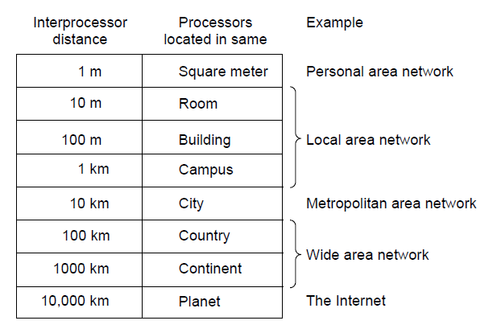
Network Hardware (2)
Classification of interconnected processors by scale.
Computer Networks, Fifth Edition by Andrew Tanenbaum and David Wetherall, © Pearson Education-Prentice Hall, 2011

Slide 11
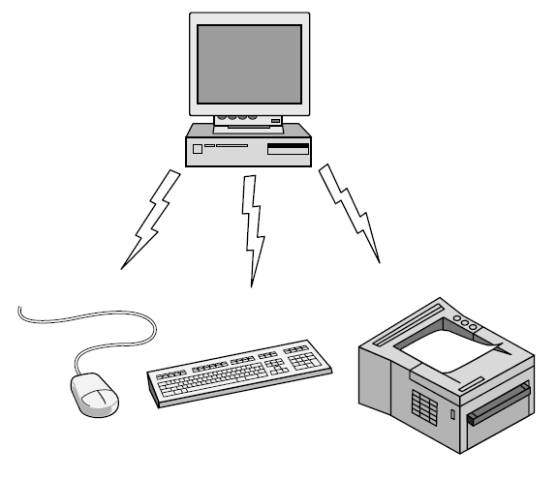
Personal Area Network
Bluetooth PAN configuration
Computer Networks, Fifth Edition by Andrew Tanenbaum and David Wetherall, © Pearson Education-Prentice Hall, 2011

Slide 12
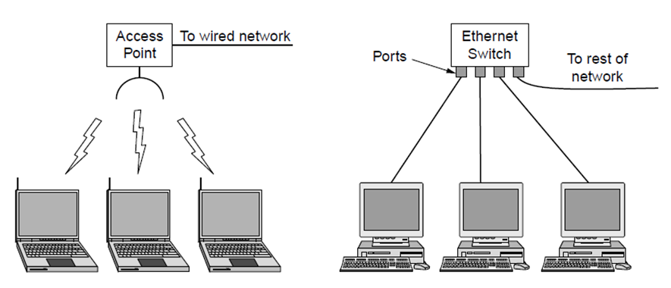
Local Area Networks
Wireless and wired LANs. (a) 802.11. (b) Switched Ethernet.
Computer Networks, Fifth Edition by Andrew Tanenbaum and David Wetherall, © Pearson Education-Prentice Hall, 2011

Slide 13
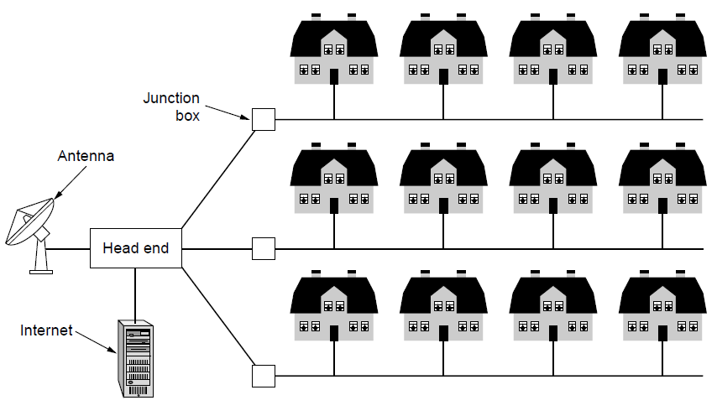
Metropolitan Area Networks
A metropolitan area network based on cable TV.
Computer Networks, Fifth Edition by Andrew Tanenbaum and David Wetherall, © Pearson Education-Prentice Hall, 2011

Slide 14
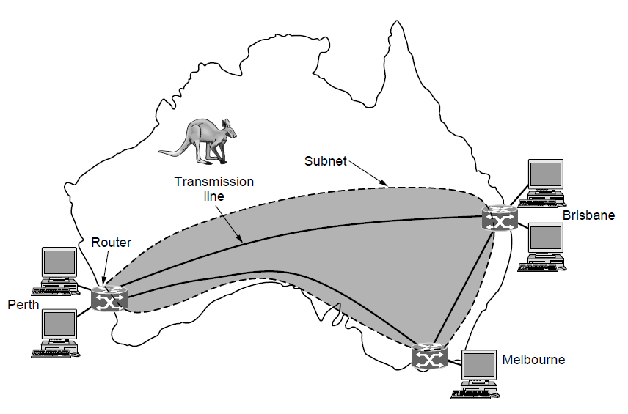
Wide Area Networks (1)
WAN that connects three branch offices in Australia
Computer Networks, Fifth Edition by Andrew Tanenbaum and David Wetherall, © Pearson Education-Prentice Hall, 2011

Slide 15
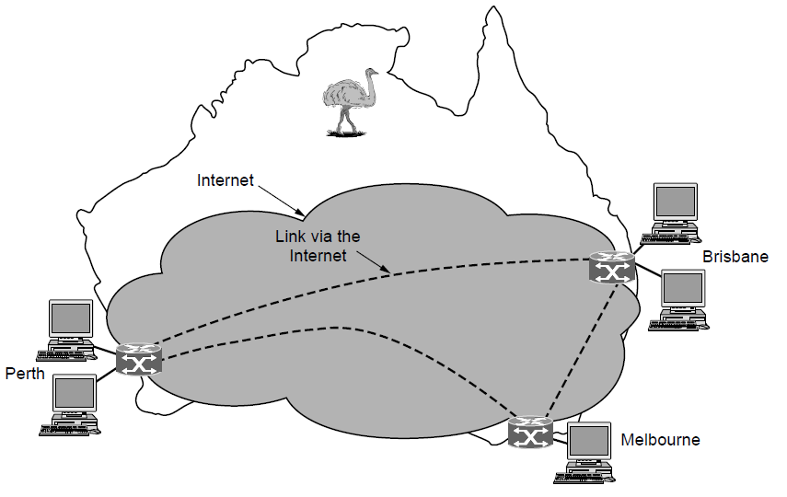
Wide Area Networks (2)
WAN using a virtual private network.
Computer Networks, Fifth Edition by Andrew Tanenbaum and David Wetherall, © Pearson Education-Prentice Hall, 2011

Slide 16
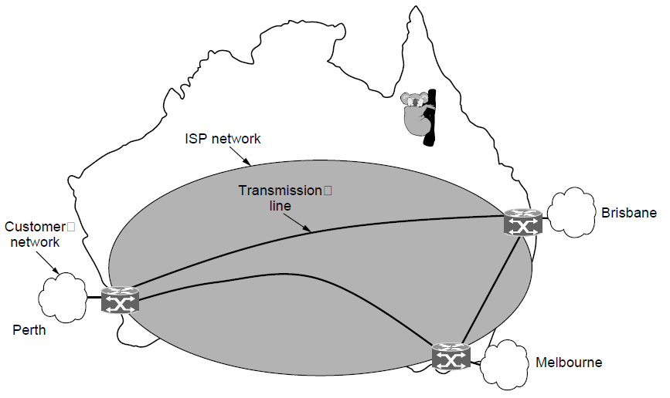
Wide Area Networks (3)
WAN using an ISP network.
Computer Networks, Fifth Edition by Andrew Tanenbaum and David Wetherall, © Pearson Education-Prentice Hall, 2011

Slide 17
Network Software
Protocol hierarchies
Design issues for the layers
Connection-oriented versus connectionless service
Service primitives
Relationship of services to protocols
Computer Networks, Fifth Edition by Andrew Tanenbaum and David Wetherall, © Pearson Education-Prentice Hall, 2011

Slide 18
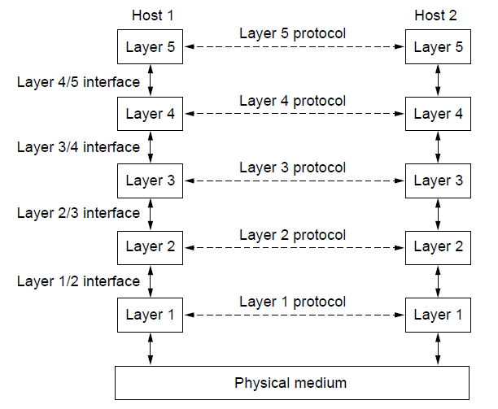
Protocol Hierarchies (1)
Layers, protocols, and interfaces.
Computer Networks, Fifth Edition by Andrew Tanenbaum and David Wetherall, © Pearson Education-Prentice Hall, 2011

Slide 19
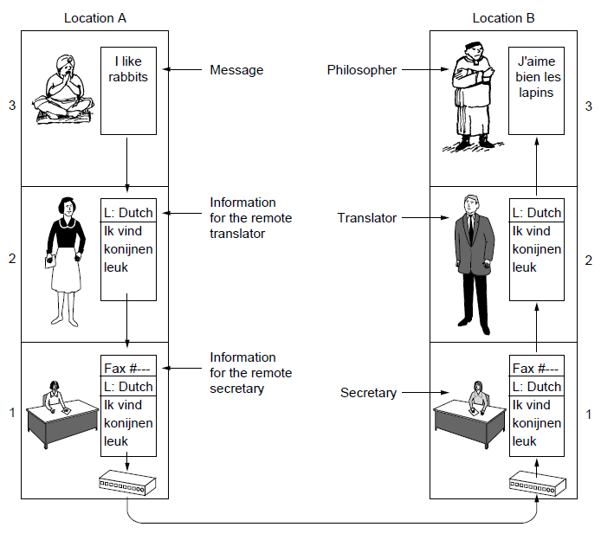
Protocol Hierarchies (2)
The philosopher-translator-secretary architecture
Computer Networks, Fifth Edition by Andrew Tanenbaum and David Wetherall, © Pearson Education-Prentice Hall, 2011

Slide 20
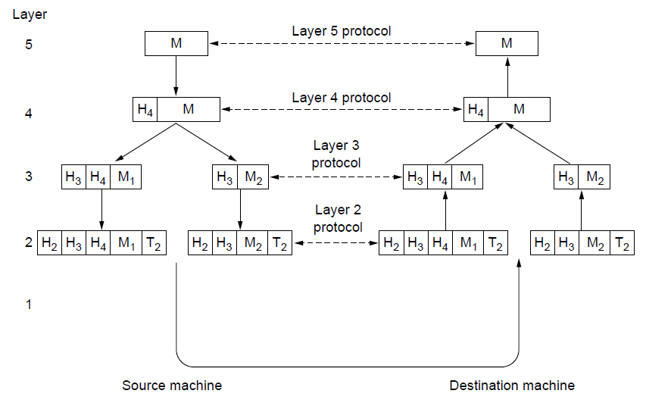
Protocol Hierarchies (3)
Example information flow supporting virtual
communication in layer 5.
Computer Networks, Fifth Edition by Andrew Tanenbaum and David Wetherall, © Pearson Education-Prentice Hall, 2011

Slide 21
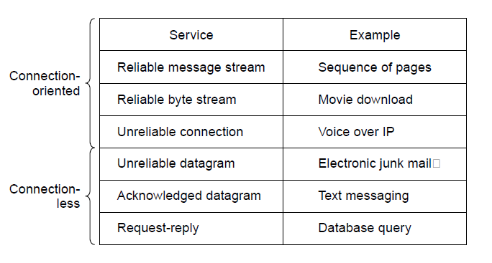
Connection-Oriented Versus
Connectionless Service
Six different types of service.
Computer Networks, Fifth Edition by Andrew Tanenbaum and David Wetherall, © Pearson Education-Prentice Hall, 2011

Slide 22
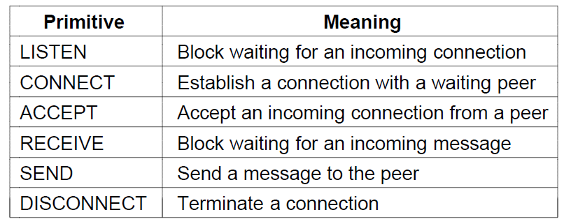
Service Primitives (1)
Six service primitives that provide a simple
connection-oriented service
Computer Networks, Fifth Edition by Andrew Tanenbaum and David Wetherall, © Pearson Education-Prentice Hall, 2011

Slide 23
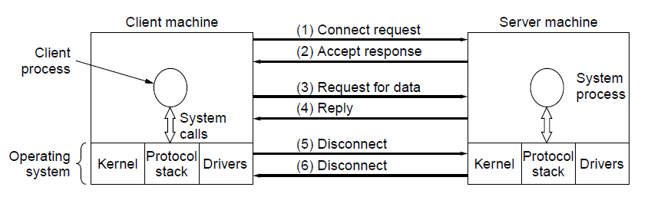
Service Primitives (2)
A simple client-server interaction using
acknowledged datagrams.
Computer Networks, Fifth Edition by Andrew Tanenbaum and David Wetherall, © Pearson Education-Prentice Hall, 2011

Slide 24
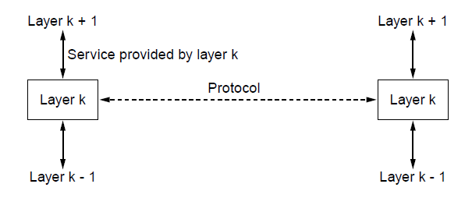
The Relationship of Services to Protocols
The relationship between a service and a protocol.
Computer Networks, Fifth Edition by Andrew Tanenbaum and David Wetherall, © Pearson Education-Prentice Hall, 2011

Slide 25
Reference Models
OSI reference model
TCP/IP reference model
Model used for this text
Comparison of OSI and TCP/IP
Critique of OSI model and protocols
Critique of TCP/IP model
Computer Networks, Fifth Edition by Andrew Tanenbaum and David Wetherall, © Pearson Education-Prentice Hall, 2011

Slide 26
The OSI Reference Model
Principles for the seven layers
Layers created for different abstractions
Each layer performs well-defined function
Function of layer chosen with definition of international standard protocols in mind
Minimize information flow across interfaces between boundaries
Number of layers optimum
Computer Networks, Fifth Edition by Andrew Tanenbaum and David Wetherall, © Pearson Education-Prentice Hall, 2011

Slide 27
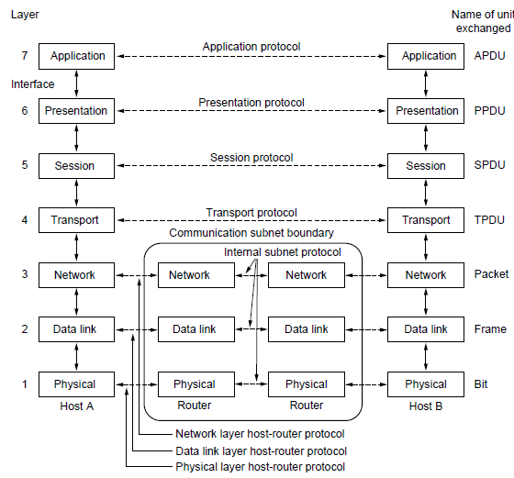
The OSI Reference Model
The OSI reference model
Computer Networks, Fifth Edition by Andrew Tanenbaum and David Wetherall, © Pearson Education-Prentice Hall, 2011

Slide 28
OSI Reference Model Layers
Physical layer
Data link layer
Network layer
Transport layer
Session layer
Presentation layer
Application layer
Computer Networks, Fifth Edition by Andrew Tanenbaum and David Wetherall, © Pearson Education-Prentice Hall, 2011

Slide 29
The TCP/IP Reference Model Layers
Link layer
Internet layer
Transport layer
Application layer
Computer Networks, Fifth Edition by Andrew Tanenbaum and David Wetherall, © Pearson Education-Prentice Hall, 2011

Slide 30
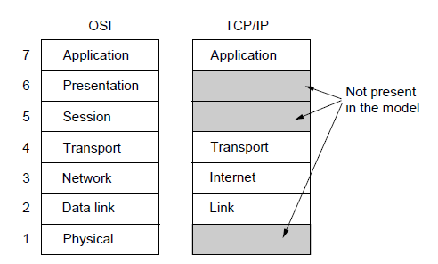
The TCP/IP Reference Model (1)
The TCP/IP reference model
Computer Networks, Fifth Edition by Andrew Tanenbaum and David Wetherall, © Pearson Education-Prentice Hall, 2011

Slide 31
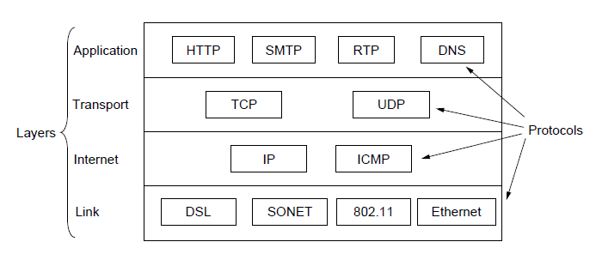
The TCP/IP Reference Model (2)
The TCP/IP reference model with some protocols we will study
Computer Networks, Fifth Edition by Andrew Tanenbaum and David Wetherall, © Pearson Education-Prentice Hall, 2011

Slide 32
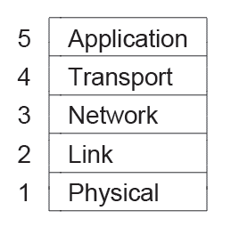
The Model Used in this Book
The reference model used in this book.
Computer Networks, Fifth Edition by Andrew Tanenbaum and David Wetherall, © Pearson Education-Prentice Hall, 2011

Slide 33
Comparison of the OSI and
TCP/IP Reference Models
Concepts central to OSI model
Services
Interfaces
Protocols
Computer Networks, Fifth Edition by Andrew Tanenbaum and David Wetherall, © Pearson Education-Prentice Hall, 2011

Slide 34
Critique of the OSI Model and Protocols
Bad timing.
Bad technology.
Bad implementations.
Bad politics.
Computer Networks, Fifth Edition by Andrew Tanenbaum and David Wetherall, © Pearson Education-Prentice Hall, 2011

Slide 35
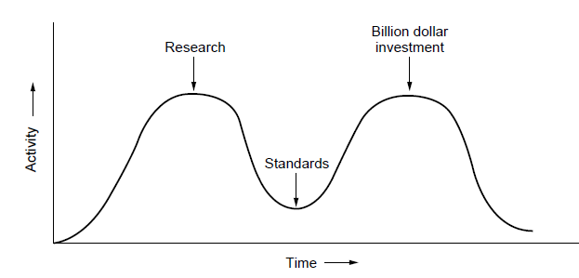
OSI Model Bad Timing
The apocalypse of the two elephants.
Computer Networks, Fifth Edition by Andrew Tanenbaum and David Wetherall, © Pearson Education-Prentice Hall, 2011

Slide 36
Example Networks
Internet
ARPANET
NSFNET
Third-generation mobile phone networks
Wireless LANs: 802.11
RFID and sensor networks
Computer Networks, Fifth Edition by Andrew Tanenbaum and David Wetherall, © Pearson Education-Prentice Hall, 2011

Slide 37
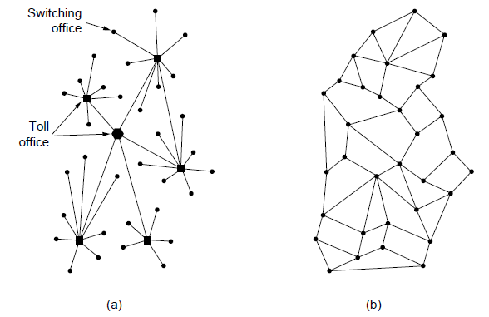
The ARPANET (1)
Structure of the telephone system.
Baran’s proposed distributed switching system.
Computer Networks, Fifth Edition by Andrew Tanenbaum and David Wetherall, © Pearson Education-Prentice Hall, 2011

Slide 38
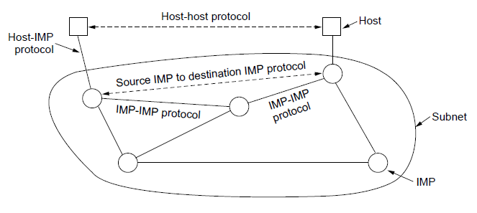
The ARPANET (2)
The original ARPANET design
Computer Networks, Fifth Edition by Andrew Tanenbaum and David Wetherall, © Pearson Education-Prentice Hall, 2011

Slide 39
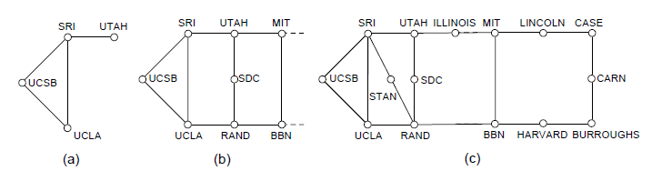
The ARPANET (3)
Growth of the ARPANET.
December 1969.
July 1970.
March 1971.
Computer Networks, Fifth Edition by Andrew Tanenbaum and David Wetherall, © Pearson Education-Prentice Hall, 2011

Slide 40
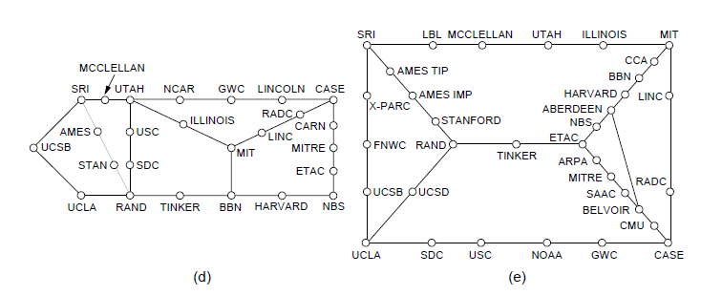
The ARPANET (4)
Growth of the ARPANET.
April 1972.
September 1972.
Computer Networks, Fifth Edition by Andrew Tanenbaum and David Wetherall, © Pearson Education-Prentice Hall, 2011

Slide 41
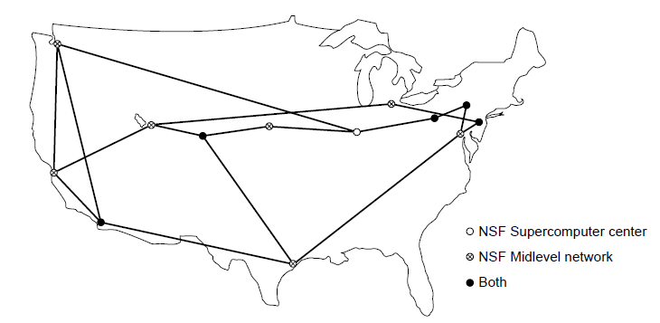
NSFNET
The NSFNET backbone in 1988.
Computer Networks, Fifth Edition by Andrew Tanenbaum and David Wetherall, © Pearson Education-Prentice Hall, 2011

Slide 42
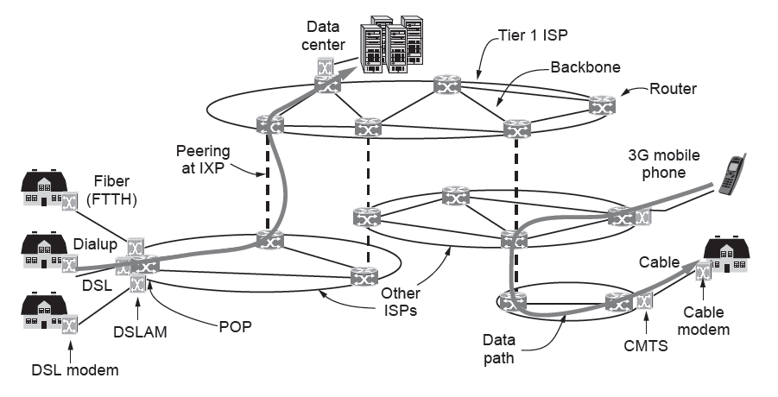
Architecture of the Internet
Overview of the Internet architecture
Computer Networks, Fifth Edition by Andrew Tanenbaum and David Wetherall, © Pearson Education-Prentice Hall, 2011

Slide 43
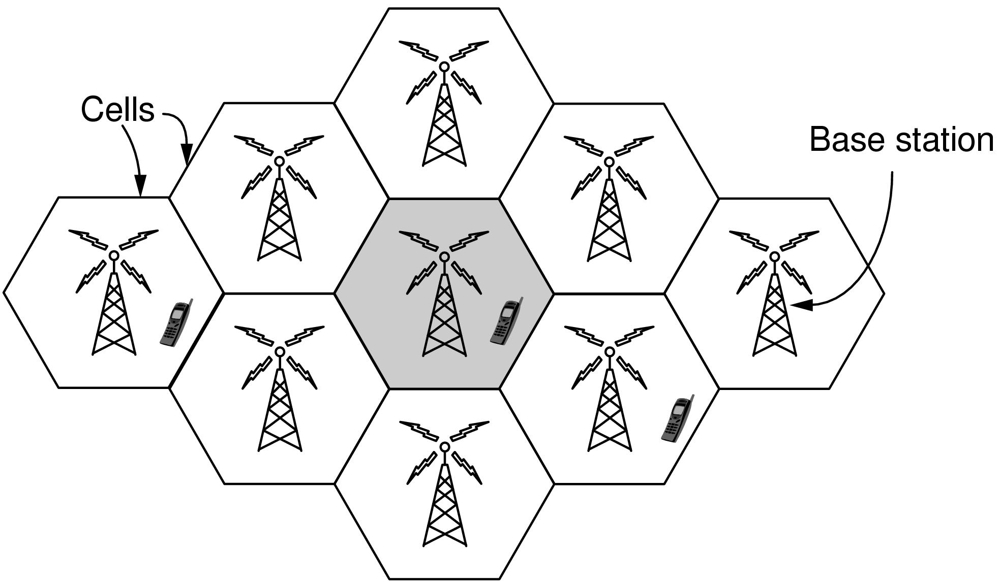
Third-Generation Mobile
Phone Networks (1)
Cellular design of mobile phone networks
Computer Networks, Fifth Edition by Andrew Tanenbaum and David Wetherall, © Pearson Education-Prentice Hall, 2011

Slide 44
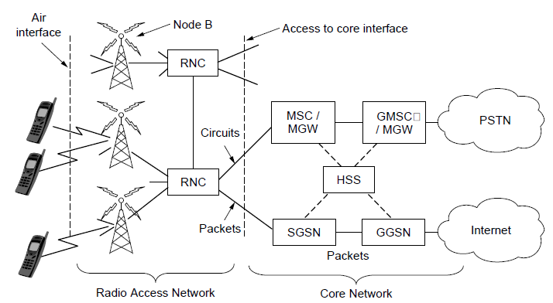
Third-Generation Mobile
Phone Networks (2)
Architecture of the UMTS 3G mobile phone network.
Computer Networks, Fifth Edition by Andrew Tanenbaum and David Wetherall, © Pearson Education-Prentice Hall, 2011

Slide 45
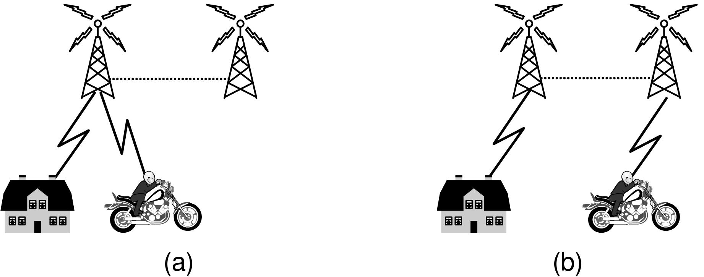
Third-Generation Mobile
Phone Networks (3)
Mobile phone handover (a) before, (b) after.
Computer Networks, Fifth Edition by Andrew Tanenbaum and David Wetherall, © Pearson Education-Prentice Hall, 2011

Slide 46
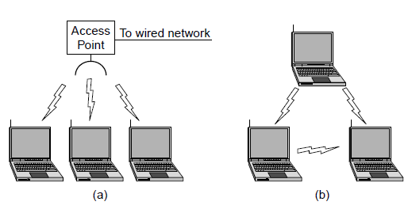
Wireless LANs: 802.11 (1)
Wireless network with an access point.
Ad hoc network.
Computer Networks, Fifth Edition by Andrew Tanenbaum and David Wetherall, © Pearson Education-Prentice Hall, 2011

Slide 47
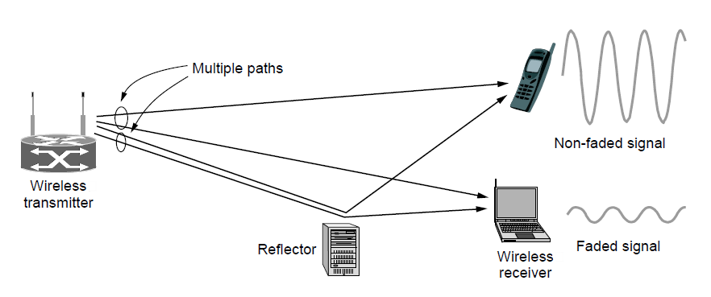
Wireless LANs: 802.11 (2)
Multipath fading
Computer Networks, Fifth Edition by Andrew Tanenbaum and David Wetherall, © Pearson Education-Prentice Hall, 2011

Slide 48
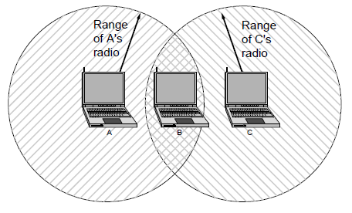
Wireless LANs: 802.11 (3)
The range of a single radio may not cover the entire system.
Computer Networks, Fifth Edition by Andrew Tanenbaum and David Wetherall, © Pearson Education-Prentice Hall, 2011

Slide 49
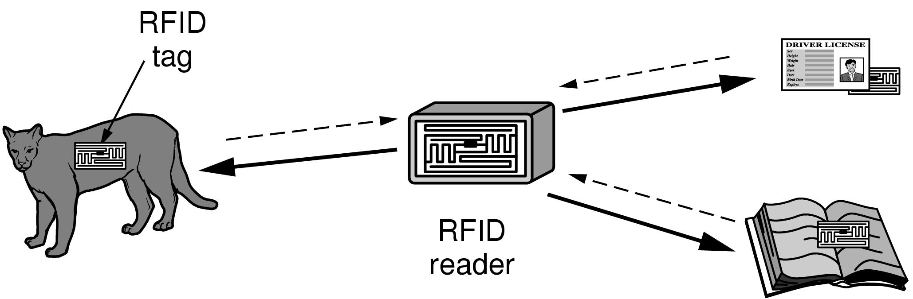
RFID and Sensor Networks (1)
RFID used to network everyday objects.
Computer Networks, Fifth Edition by Andrew Tanenbaum and David Wetherall, © Pearson Education-Prentice Hall, 2011

Slide 50
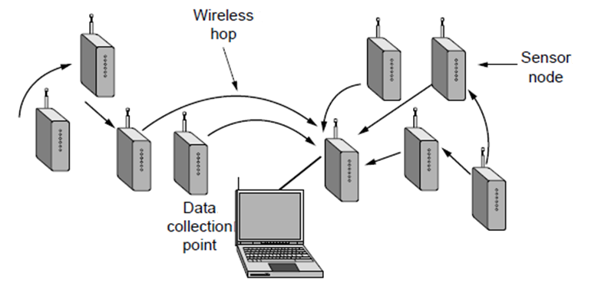
RFID and Sensor Networks (2)
Multihop topology of a sensor network
Computer Networks, Fifth Edition by Andrew Tanenbaum and David Wetherall, © Pearson Education-Prentice Hall, 2011

Slide 51
Network Standardization
Who’s Who in telecommunications
Who’s Who in international standards
Who’s Who in internet standards
Computer Networks, Fifth Edition by Andrew Tanenbaum and David Wetherall, © Pearson Education-Prentice Hall, 2011

Slide 52
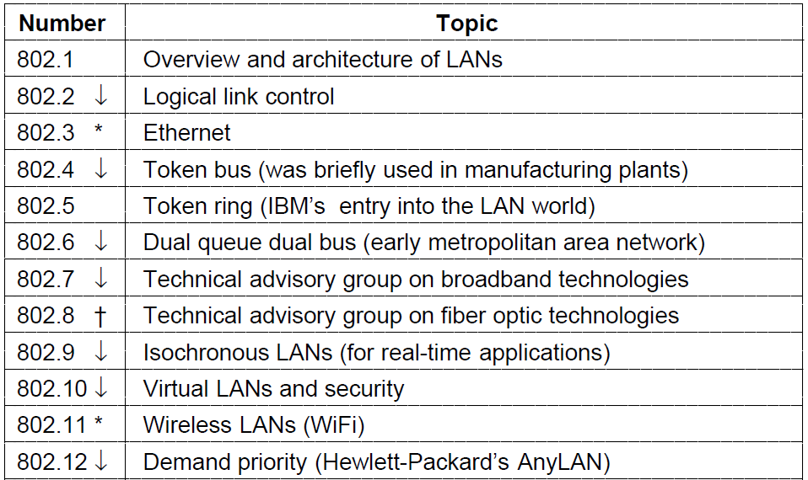
Who’s Who in International Standards (1)
The 802 working groups. The important ones are marked with *.
The ones marked with ↓ are hibernating. The one marked with † gave up and disbanded itself.
Computer Networks, Fifth Edition by Andrew Tanenbaum and David Wetherall, © Pearson Education-Prentice Hall, 2011

Slide 53
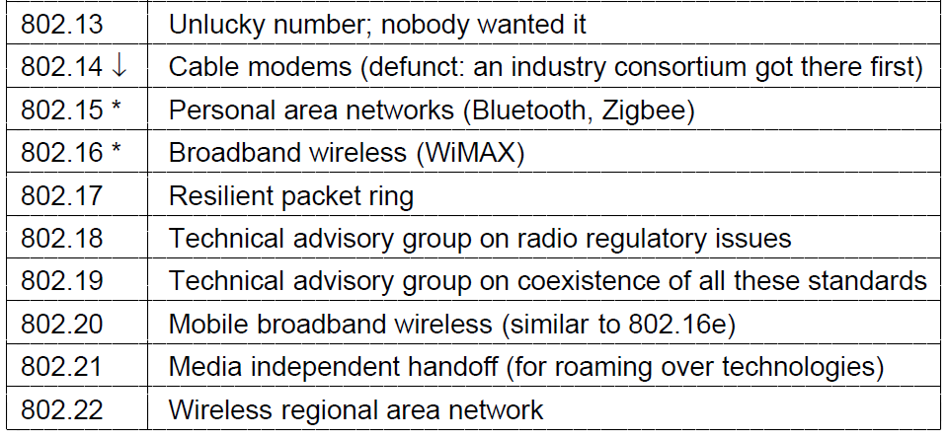
Who’s Who in International Standards (2)
The 802 working groups. The important ones are marked with *.
The ones marked with ↓ are hibernating. The one marked with † gave up and disbanded itself.
Computer Networks, Fifth Edition by Andrew Tanenbaum and David Wetherall, © Pearson Education-Prentice Hall, 2011

Slide 54
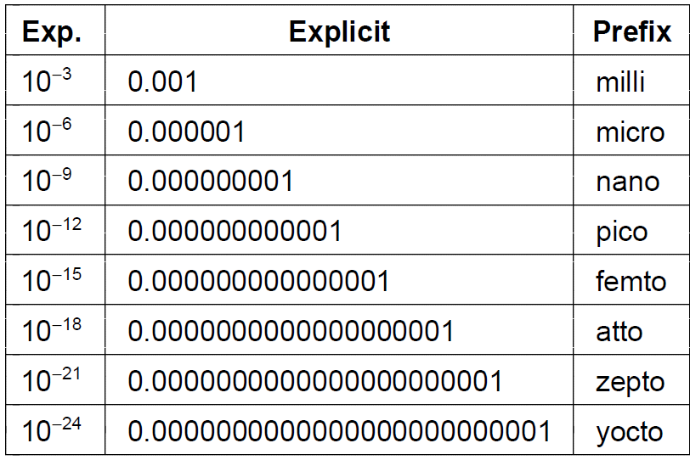
Metric Units (1)
The principal metric prefixes
Computer Networks, Fifth Edition by Andrew Tanenbaum and David Wetherall, © Pearson Education-Prentice Hall, 2011

Slide 55
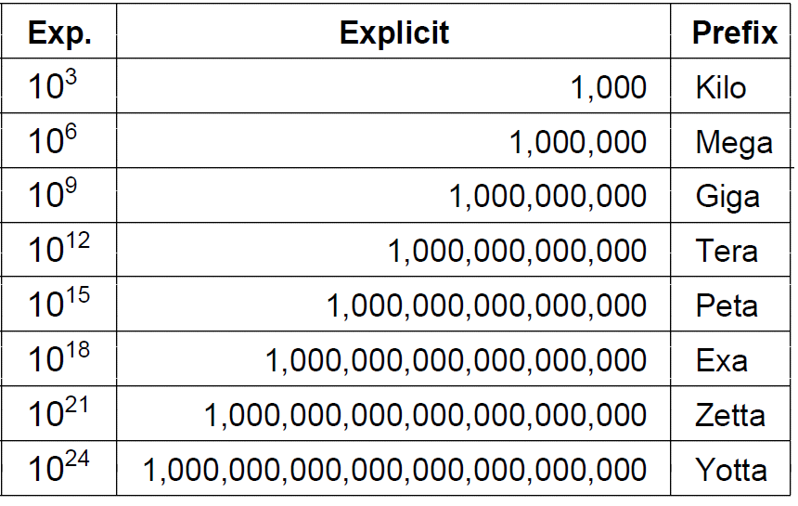
Metric Units (2)
The principal metric prefixes
Computer Networks, Fifth Edition by Andrew Tanenbaum and David Wetherall, © Pearson Education-Prentice Hall, 2011

Slide 56
End
Chapter 1
Computer Networks, Fifth Edition by Andrew Tanenbaum and David Wetherall, © Pearson Education-Prentice Hall, 2011

